Slide 1
Nifty Fifty

Slide 2
Calvin Morin
Employee Owner at Steel-Pro since 2014
Lead Fabricator
Vice Chair of EOCC committee
Head of Volunteer Outreach

Slide 3
Start an Employee Owner Communications Committee
Strength through diversity
Many hands make light work
Employee Owner Culture Committee

Slide 4
Employee Showcase
Companywide email sent once a week
Allows coworkers to build each other up
Intentional focus on the positive

Slide 5
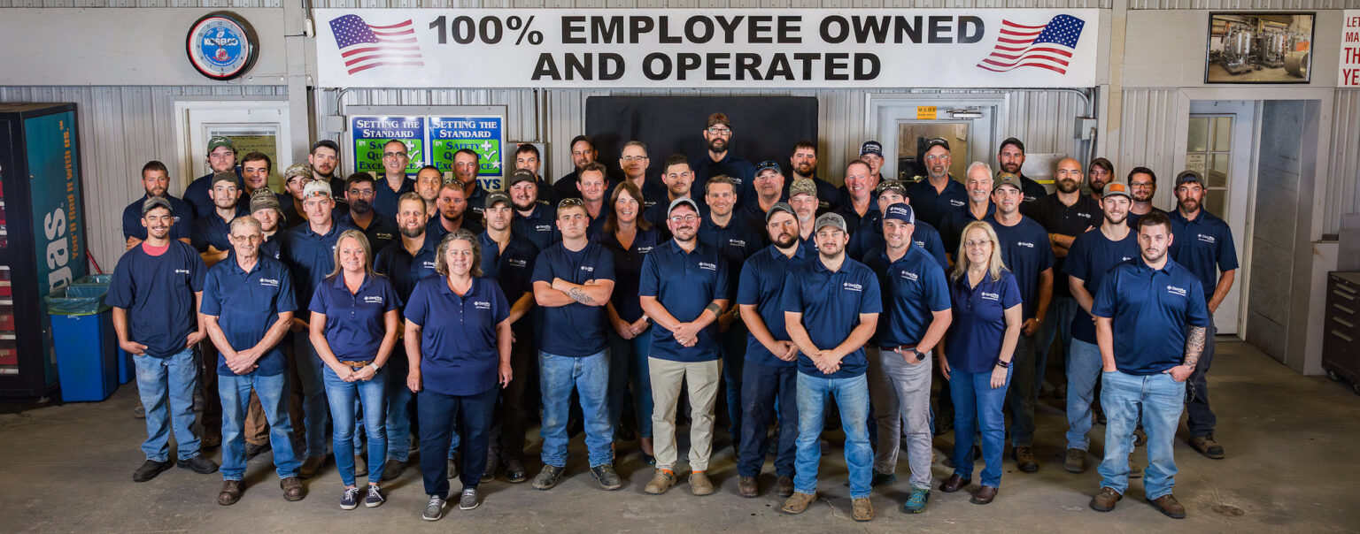
See It, Own It, Fix It Thinking like an owner

Slide 6
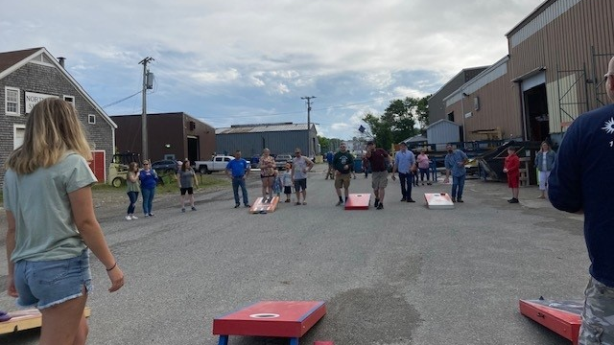
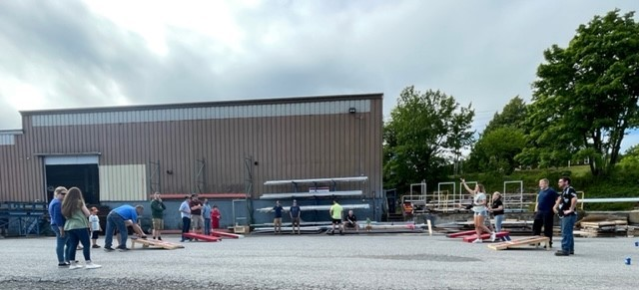
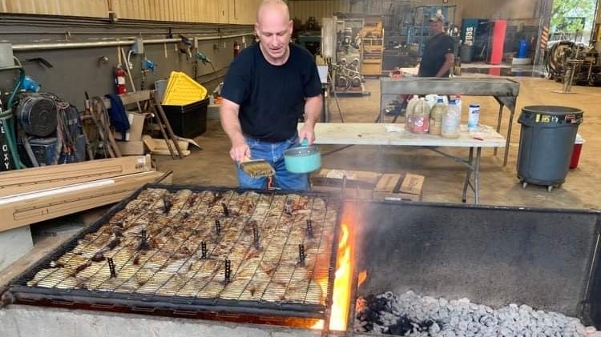
Summer Family Cornhole BBQ

Slide 7
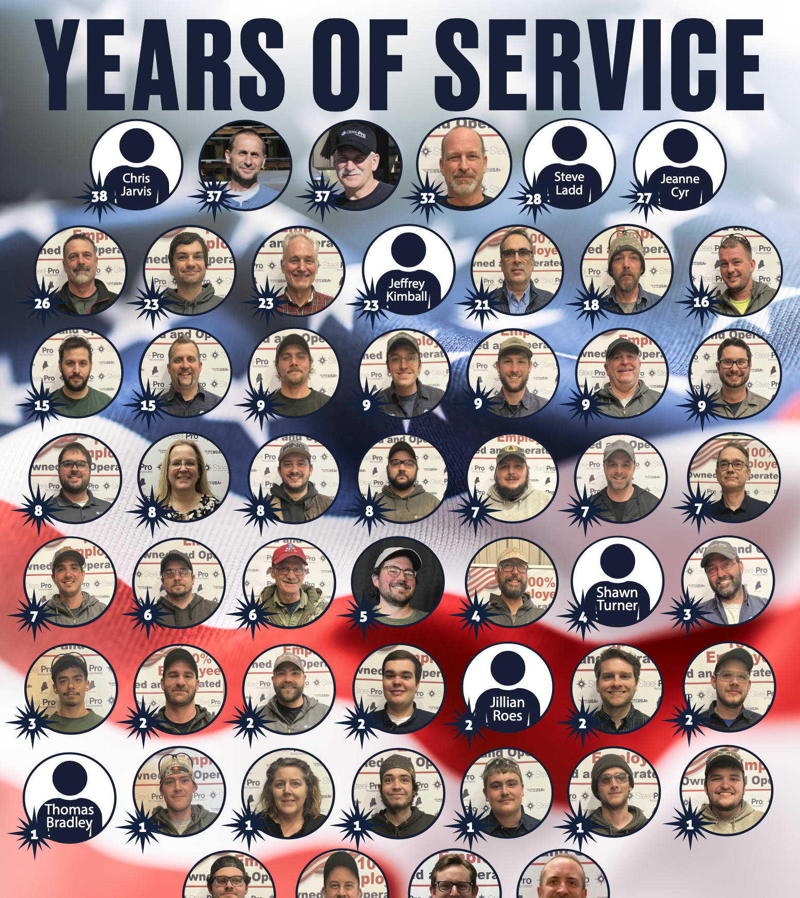
YEARS OF SERVICE POSTER

Slide 8
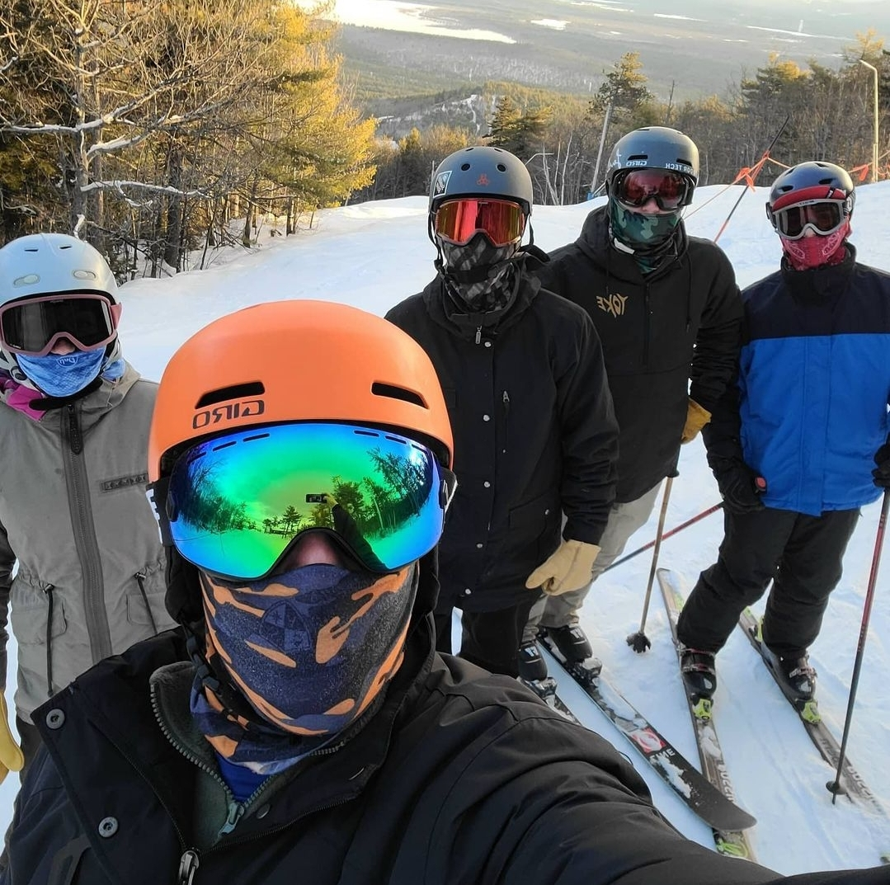
Team Building Trips

Slide 9
Steel – Pro Library
Ownership & Leadership titles for employees to "Check Out" and read

Slide 10
Podcast Library
"What are you listening to today?"

Slide 11
Community Service

Slide 12
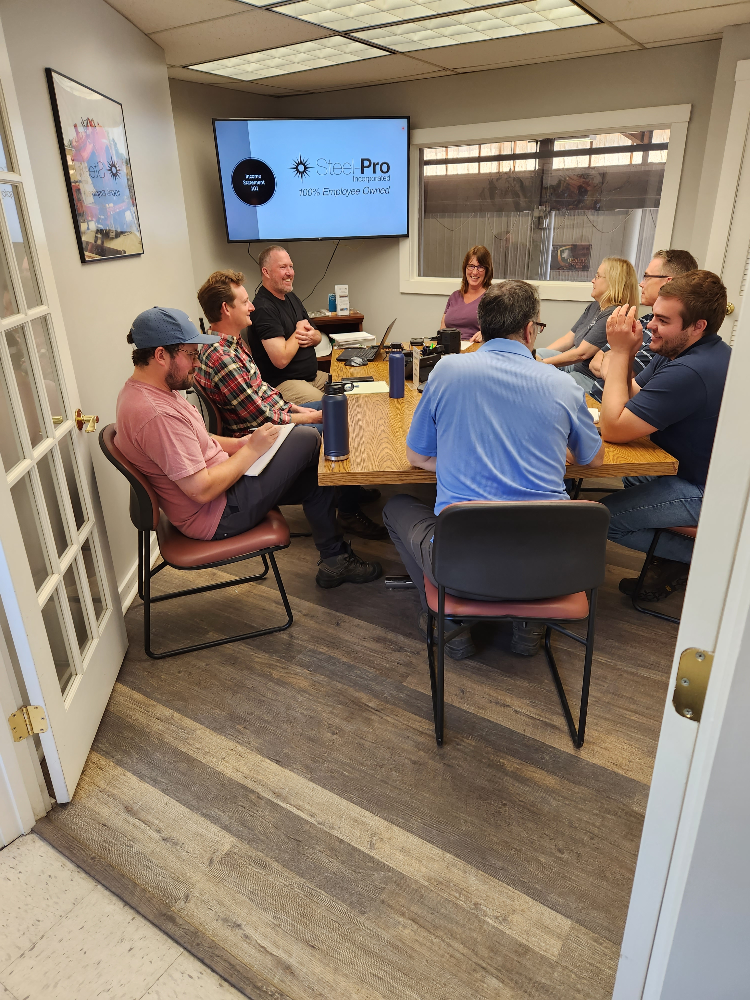
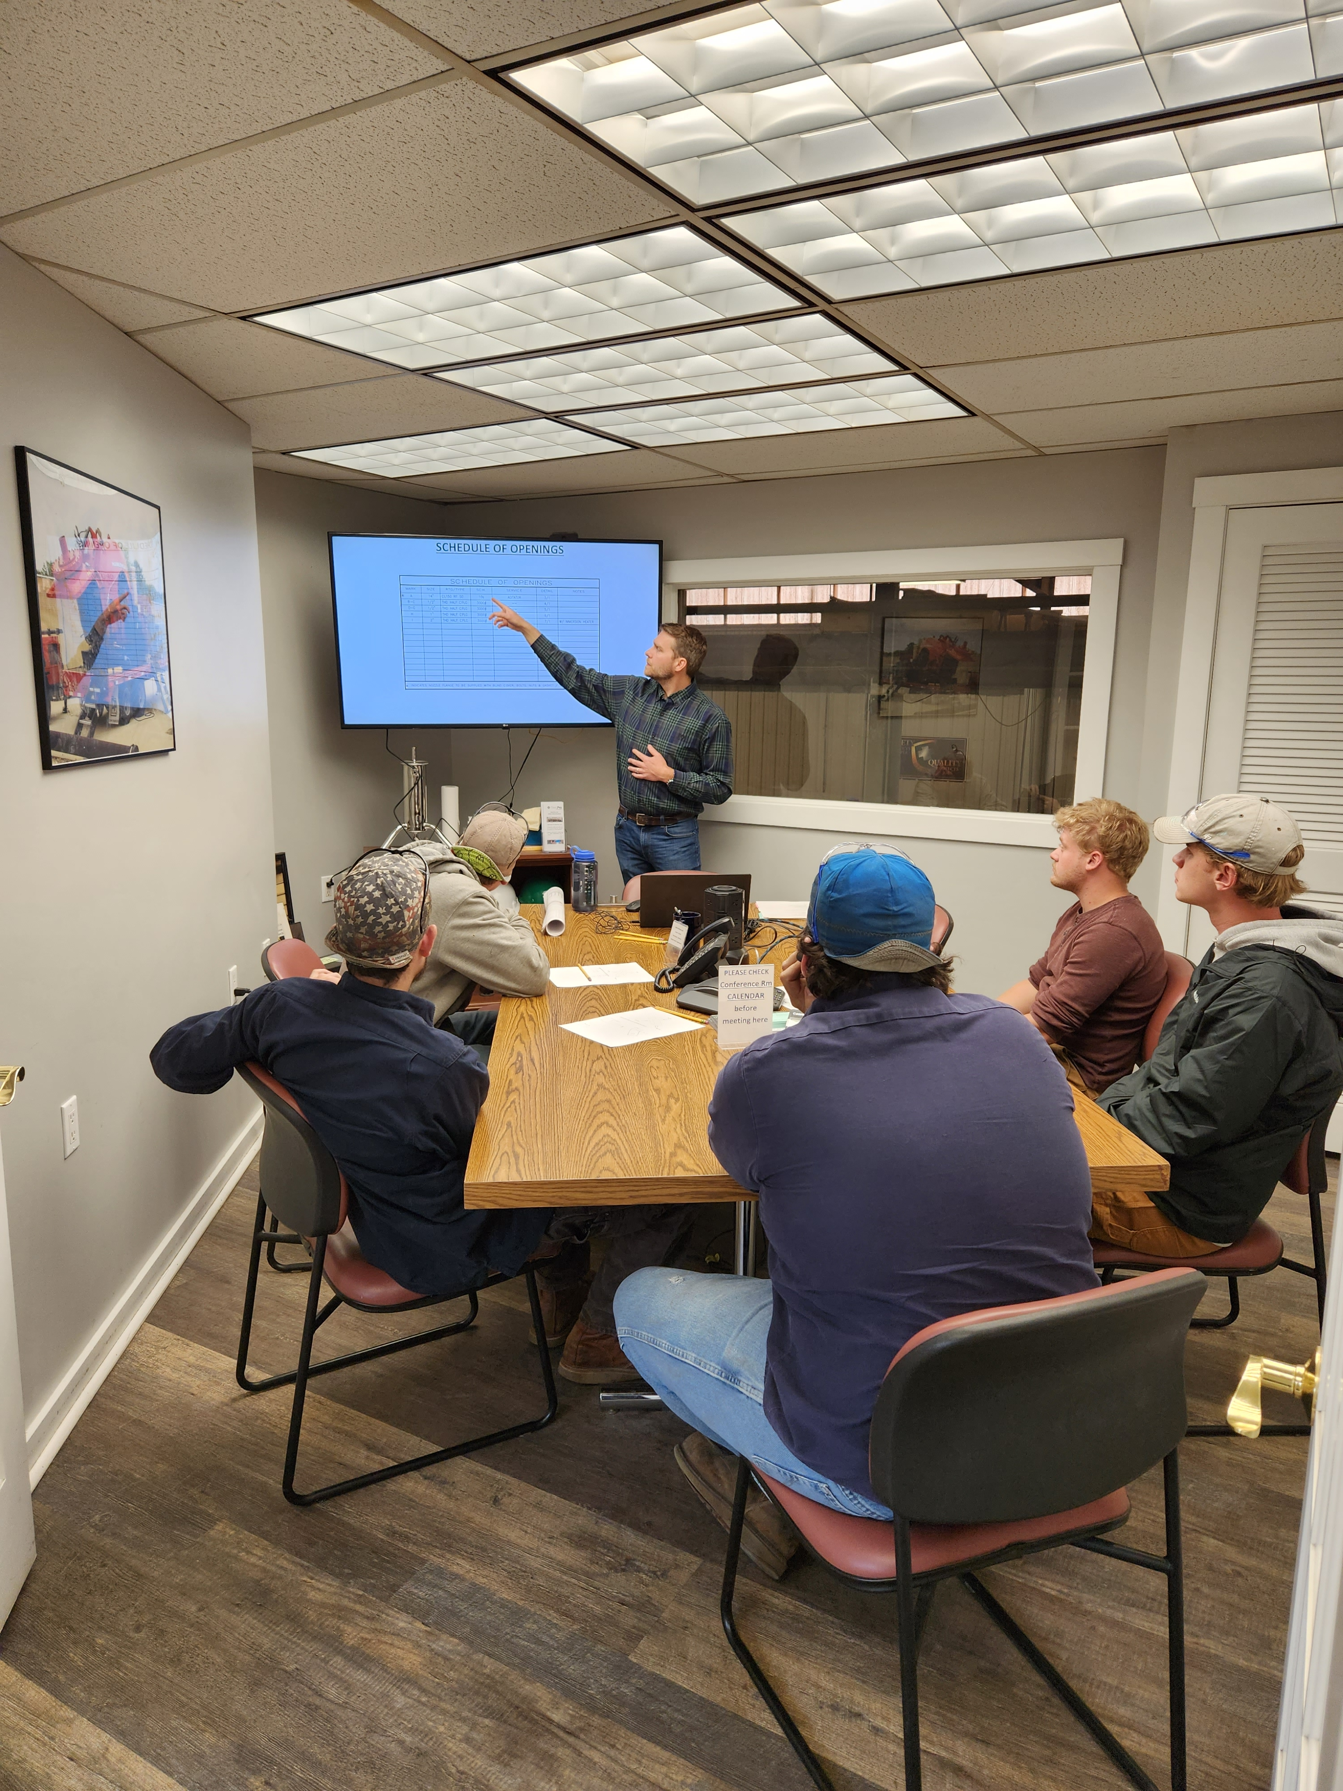
Company Education Courses
Finance 101
Profit/Loss
Project Quote Intro
Fabrication Math

Slide 13
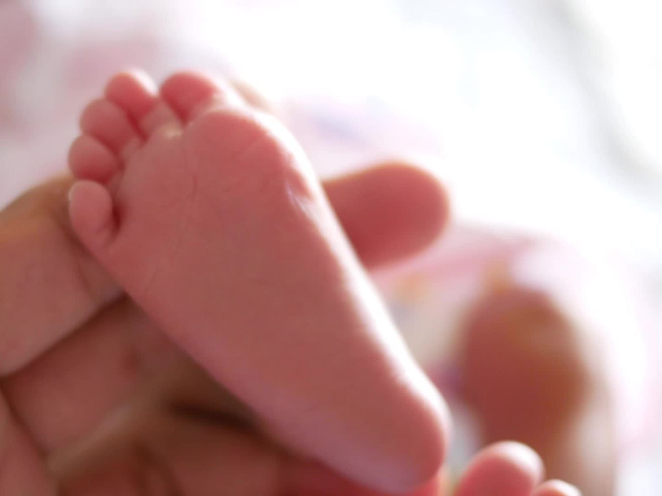
It's a Baby!

Slide 14
ESOP Trivia through October

Slide 16
Cribbage Tournament

Slide 17
YETI Mug Upon entering the ESOP after 1 year of service

Slide 19
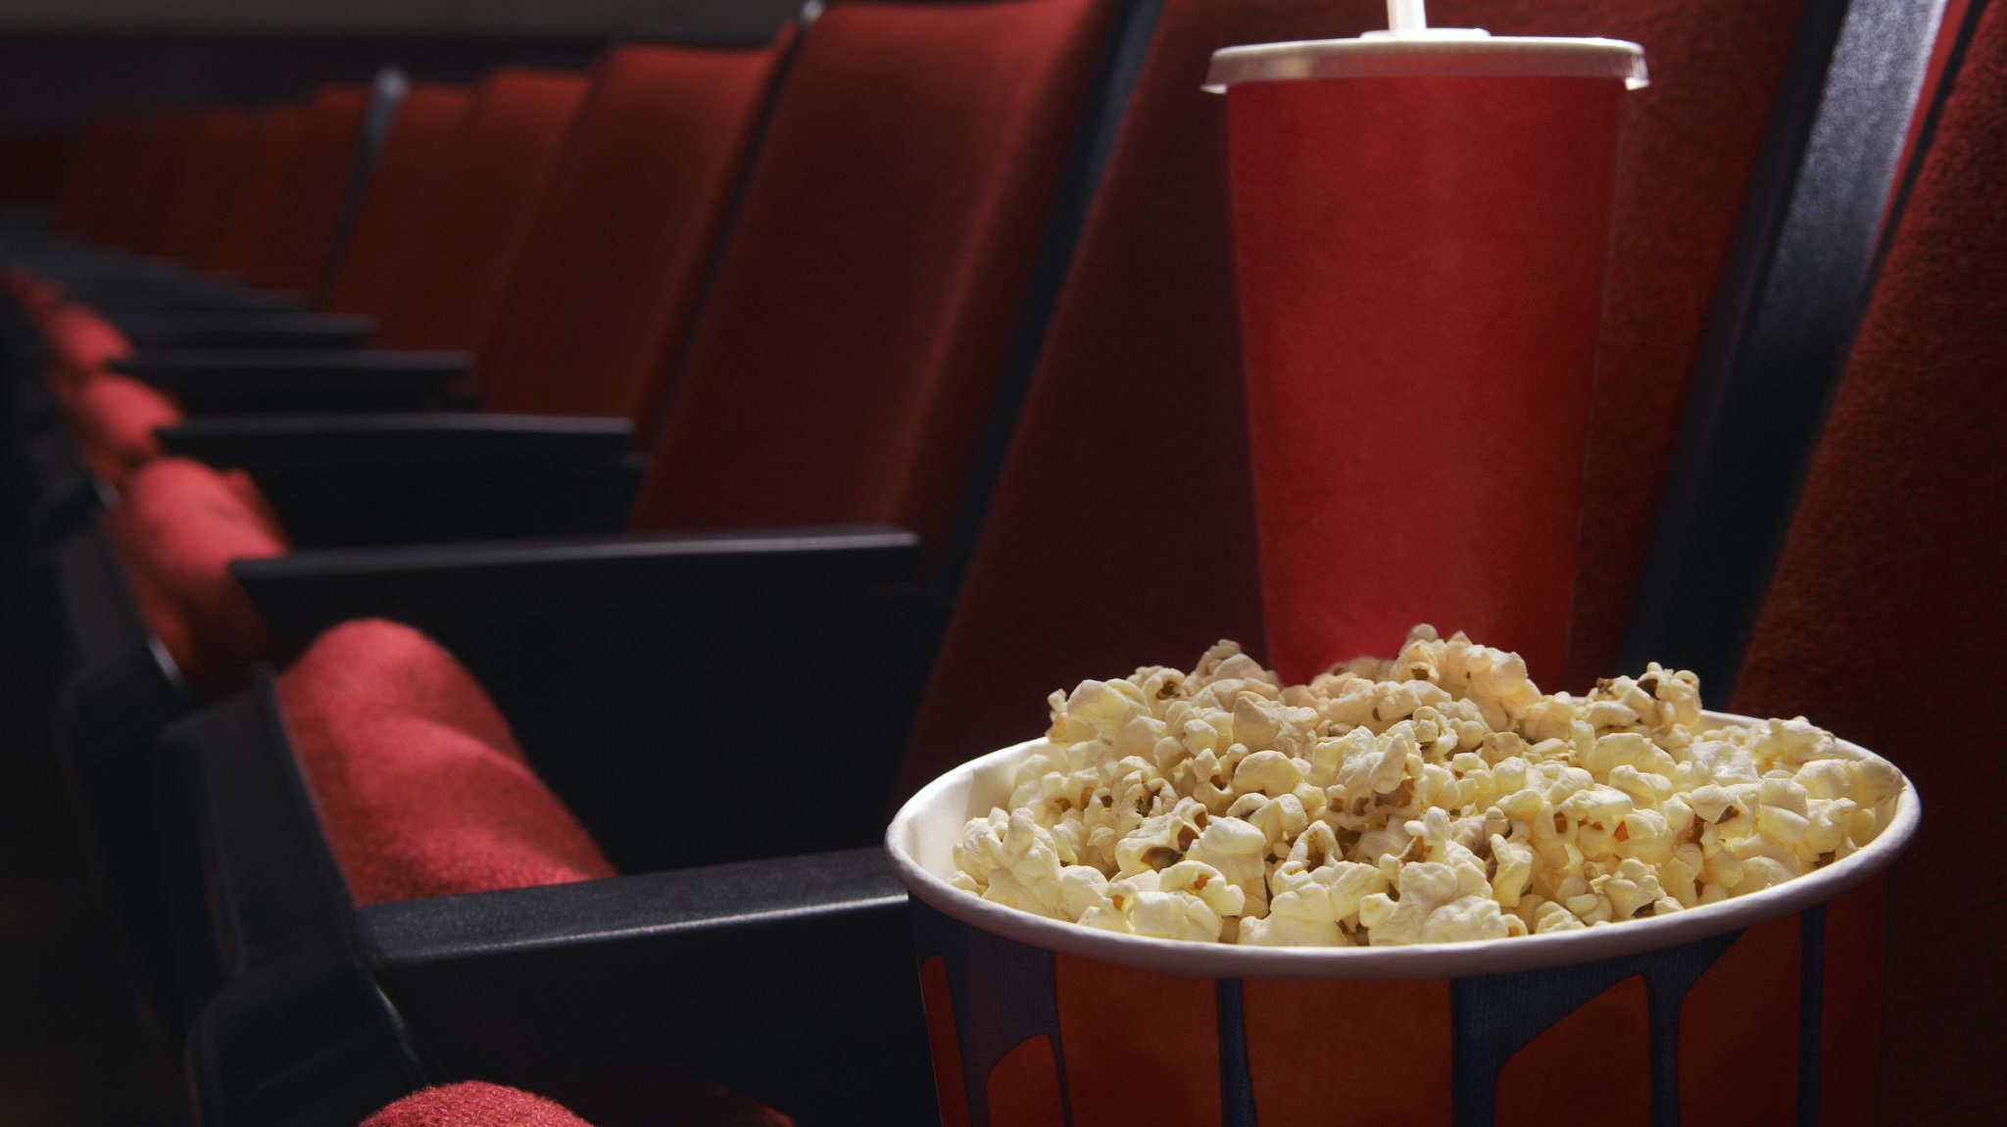
Company Movie Night

